Slide 1
Lesson 12 OOP
Reviewing properties and non-public attributes Applying it to Inheritance Enums

Slide 2
Review/reminder of the way properties work - public, protected, and private
If a class defines a property, a “hidden” attribute is created. That attribute has the same name as the property with an underscore.
In the body of the getter and setter, you need to return/set the value of the attribute - meaning the variable with the underscore. Do NOT return/set the value of the property or you will get a recursion error. This is because you are inside the property definition and then calling the property. Let’s see this in action.

Slide 3
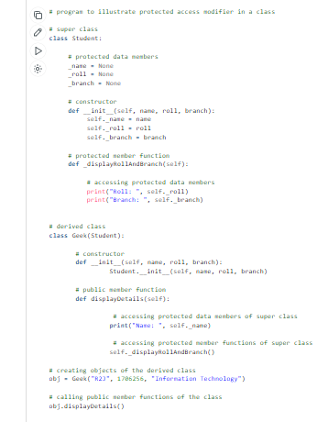
Accessing non-public attributes in a derived class
Private attributes (with a double underscore) that are part of the Base class cannot be access in a derived class.
Non-public attributes (or protected attributes) of the Base class CAN be accessed inside the derived class. (Non-public attributes have a single underscore. It is usually discouraged practice to access an attribute with a single underscore outside of the class that it is defined. The exception is in a derived class where it is fine to access the protected attribute).

Slide 4
Inheritance Practice
Dataquest for queues. Do the whole mission:
https://app.dataquest.io/c/108/m/561/queues/1/introduction
Dataquest for stacks: do the first 4 steps:
https://app.dataquest.io/c/108/m/562/stacks/1/introduction?path=3&slug=data-engineer

Slide 5
NOT Homework - in the end
Self learning. Topic: enums:
https://www.pythontutorial.net/python-oop/python-enumeration/
You will probably need to know this topic for the assignment next lesson. (it is a simple topic)

